Slide 1
DKN: Deep Knowledge-Aware Network for News Recommendation
Advisor: Jia-Ling Koh
Presenter: You-Xiang Chen
Source: www 2018
Data: 2019/06/10

Slide 2
Outline
Introduction
Method
Experiment
Conclusion

Slide 3
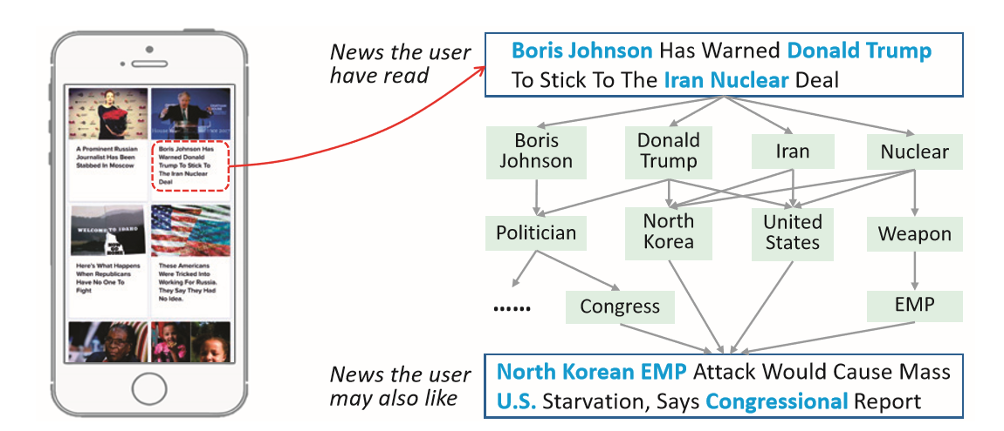
Motivation
Traditional semantic models can only find their relatedness based on co-occurrence of words, but hardly discover their latent knowledge-level connection.

Slide 4
Challenges
News language is usually highly condensed and comprised of a large amount of knowledge entities and common sense.
People are topic-sensitive in news reading as they are usually interested in multiple specific news categories.
Notes:
新聞的特色

Slide 5
Goal
Designing knowledge-aware convolutional neural networks (KCNN), to fuse the word-level and knowledge-level representations of news and generate a knowledge aware embedding vector.
Using an attention module to automatically match candidate news to each piece of clicked news, and aggregate the user’s history with different weights.

Slide 6
Outline
Introduction
Method
Experiment
Conclusion

Slide 7
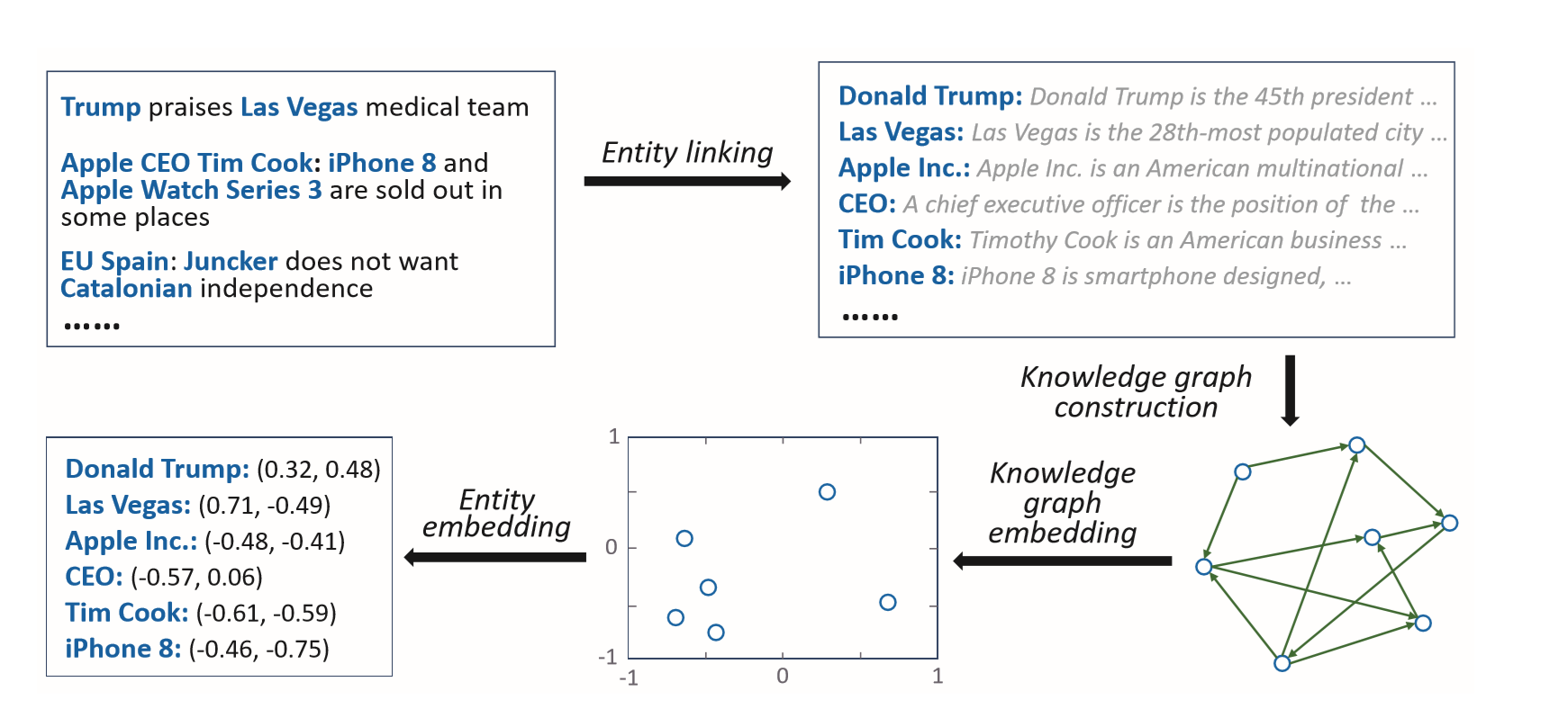
Knowledge Graph Embedding
The goal of knowledge graph embedding is to learn a low-dimensional representation vector for each entity and relation.

Slide 8
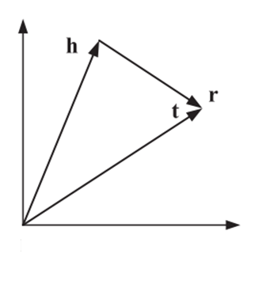
Knowledge Graph Embedding
Knowledge graph consists of entity-relationentity triples (h, r, t)
Entity and relation Space

Slide 9
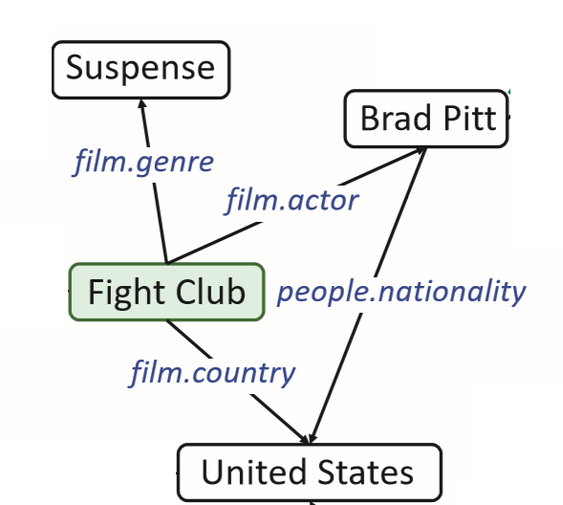
Translational Distance Model
TransE
t
r
h
Notes:
E and D

Slide 10
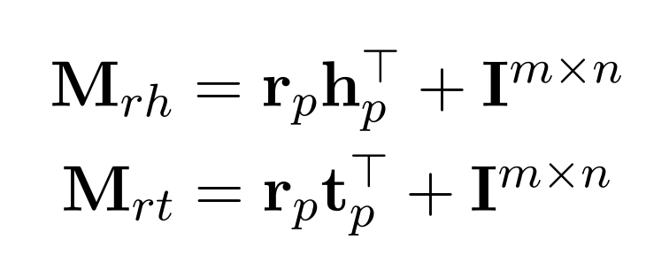
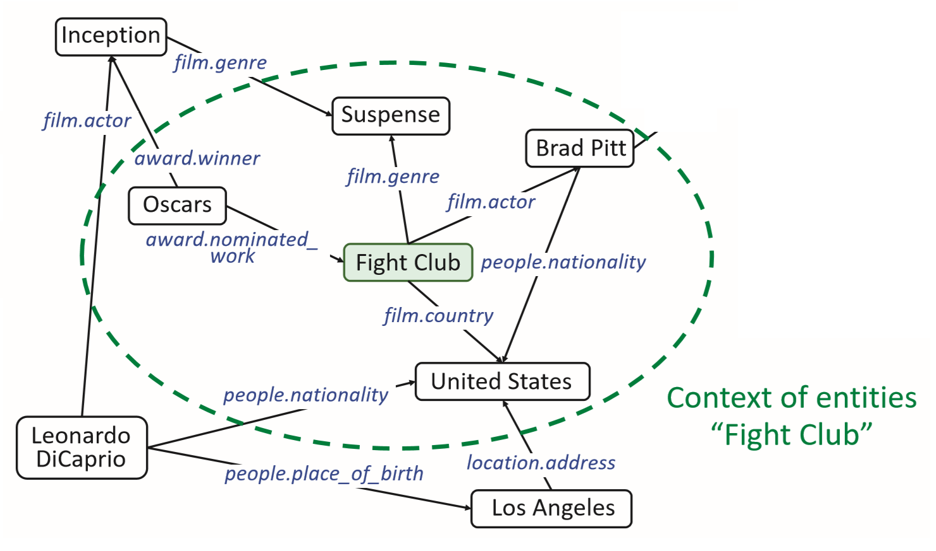
Translational Distance Model
TransD
Notes:
E and D

Slide 11
Knowledge Graph Embedding
Margin-based ranking loss
Notes:
舉例

Slide 12
DKN framework
News title
Notes:
先講大致

Slide 13
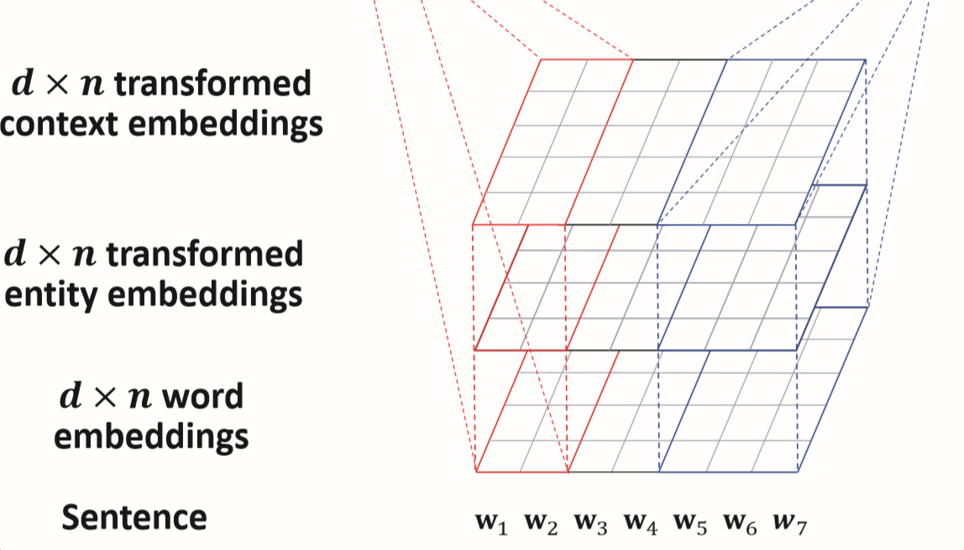
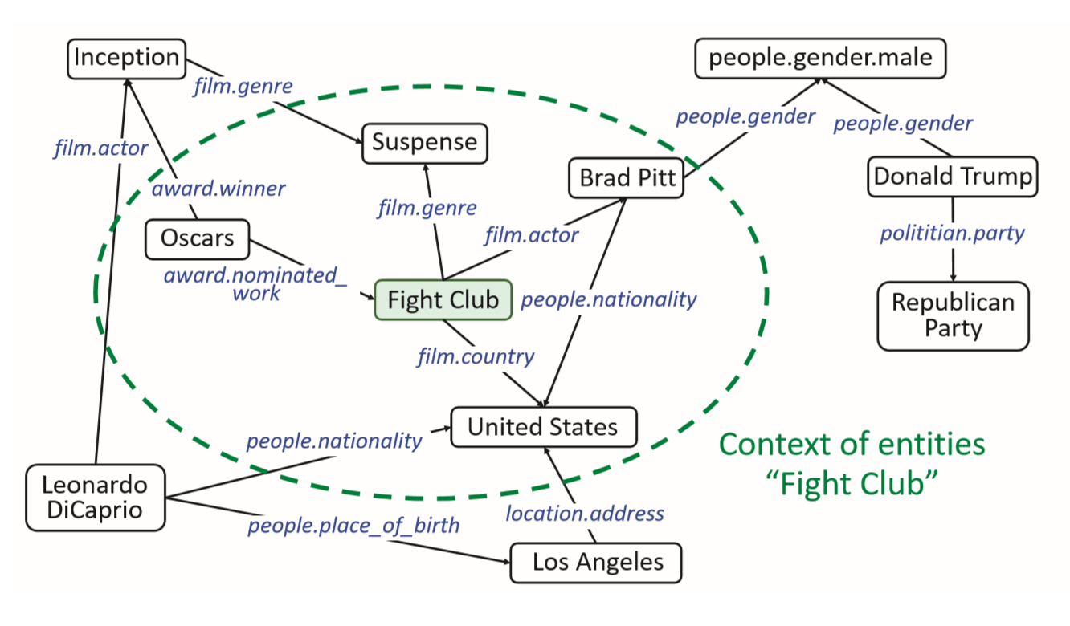
Knowledge Distillation
Context embedding

Slide 14
Knowledge-aware CNN
Straightforward way to concatenate words and entities

Slide 15
Knowledge-aware CNN
Multi-channel input W

Slide 16
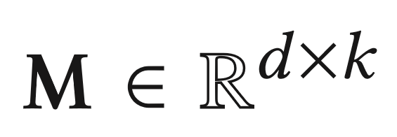
Knowledge-aware CNN
Transformation entity embeddings
$ℊ$ is the transformation function , where can be either linear
or non-linear

Slide 17
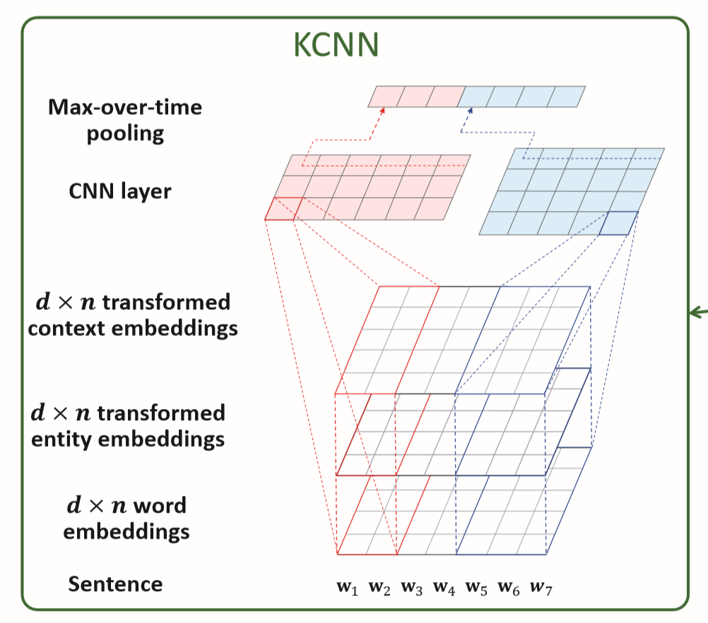
Knowledge-aware CNN
Multiple filters $h∈ ℝ^{d×l×3}$ with varying window sizes $l$

Slide 18
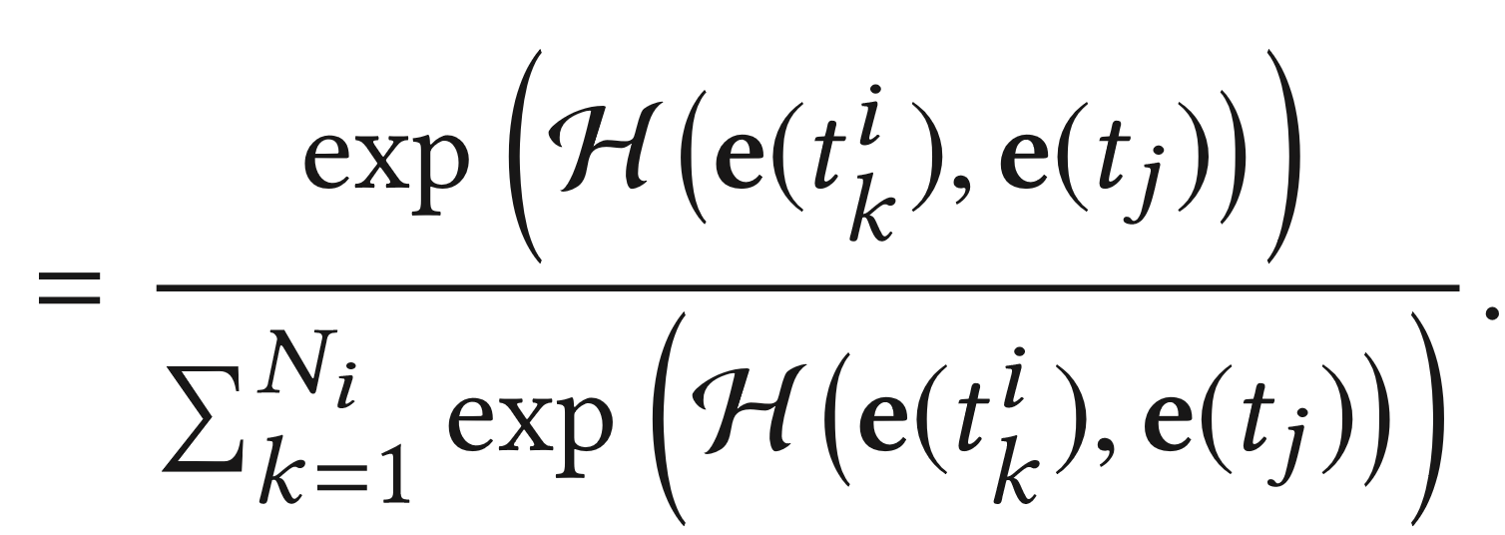
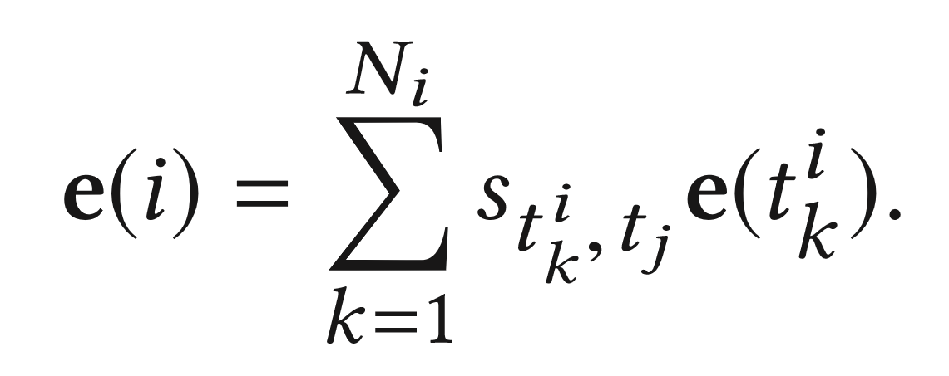
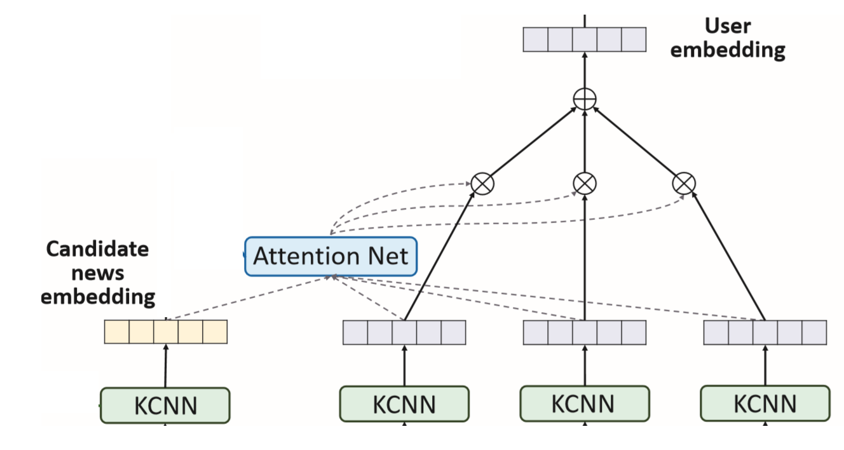
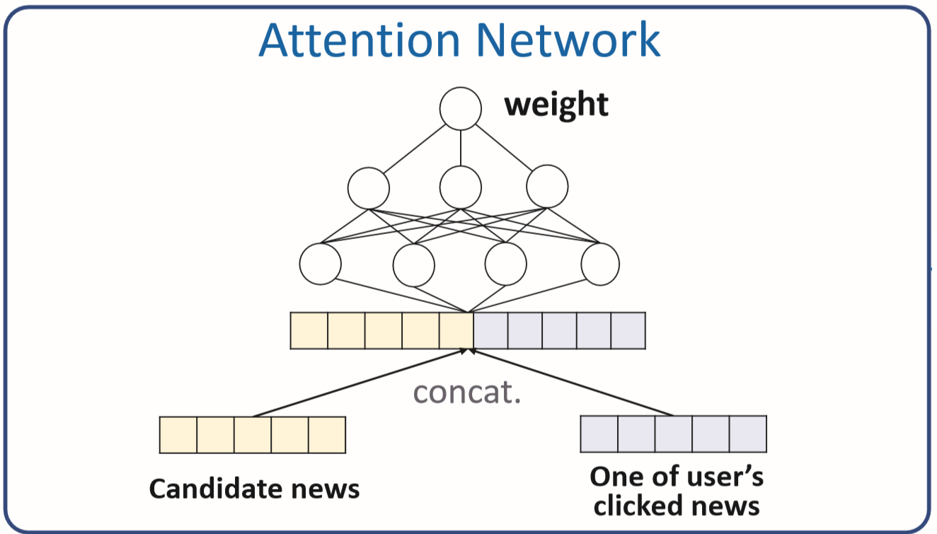
Attention Net
Calculate the normalized impact weight

Slide 19
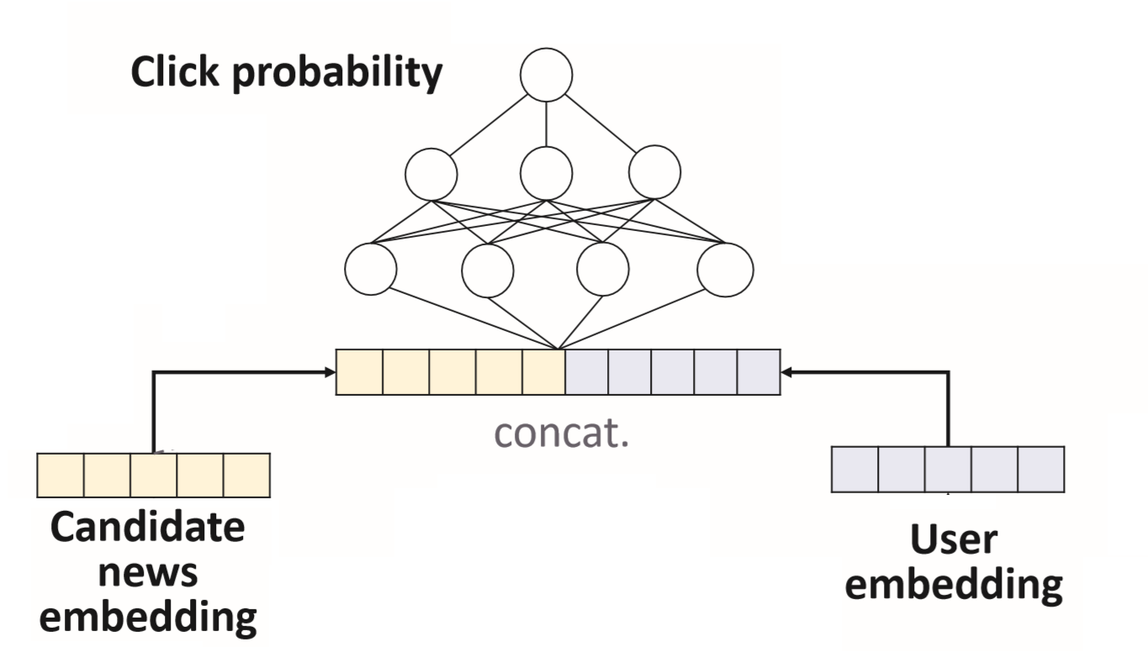
Prediction

Slide 20
Outline
Introduction
Method
Experiment
Conclusion

Slide 21
Datasets

Slide 22
Comparison of different models
Notes:
LibFM : 一種做 FM 的方法
KPCNN : input word sequence of news title into Kim CNN to learn representation
DSSM : using word hashing for document ranking and multiple fully-connected layer
DeepWide : combines a component of factorization machines and a component of deep neural networks that share the input 提出了一个结合使用了非线性特征的线性模型和一个用来embedding特征的深度学习
YouTubeNet : deep candidate generation network and a deep ranking network
DMF : multiple non-linear layers 的架構，來計算用戶特徵和物品特徵的相似度

Slide 23
Comparison among DKN variants

Slide 24
Case Study

Slide 25
Case Study

Slide 26
Outline
Introduction
Method
Experiment
Conclusion

Slide 27
Conclusion
We design a KCNN module in DKN to jointly learn from semantic-level and knowledge-level representations of news.
Using an attention module to dynamically calculate a user’s aggregated historical representation.

